Slide 1

Underground Hero Organisation System
Main Flow
Aditional Elements
Game
Context
Intro in the game
Game
starts
Player
Registration
Hero Leader board
Player
Login
Fill 6 Boxes
Last
requirement
Game
Summary
Level
Counter clock
Player
Profile
Theme
Picker
Player
History
Game
Settings
Player Achievements

Slide 2
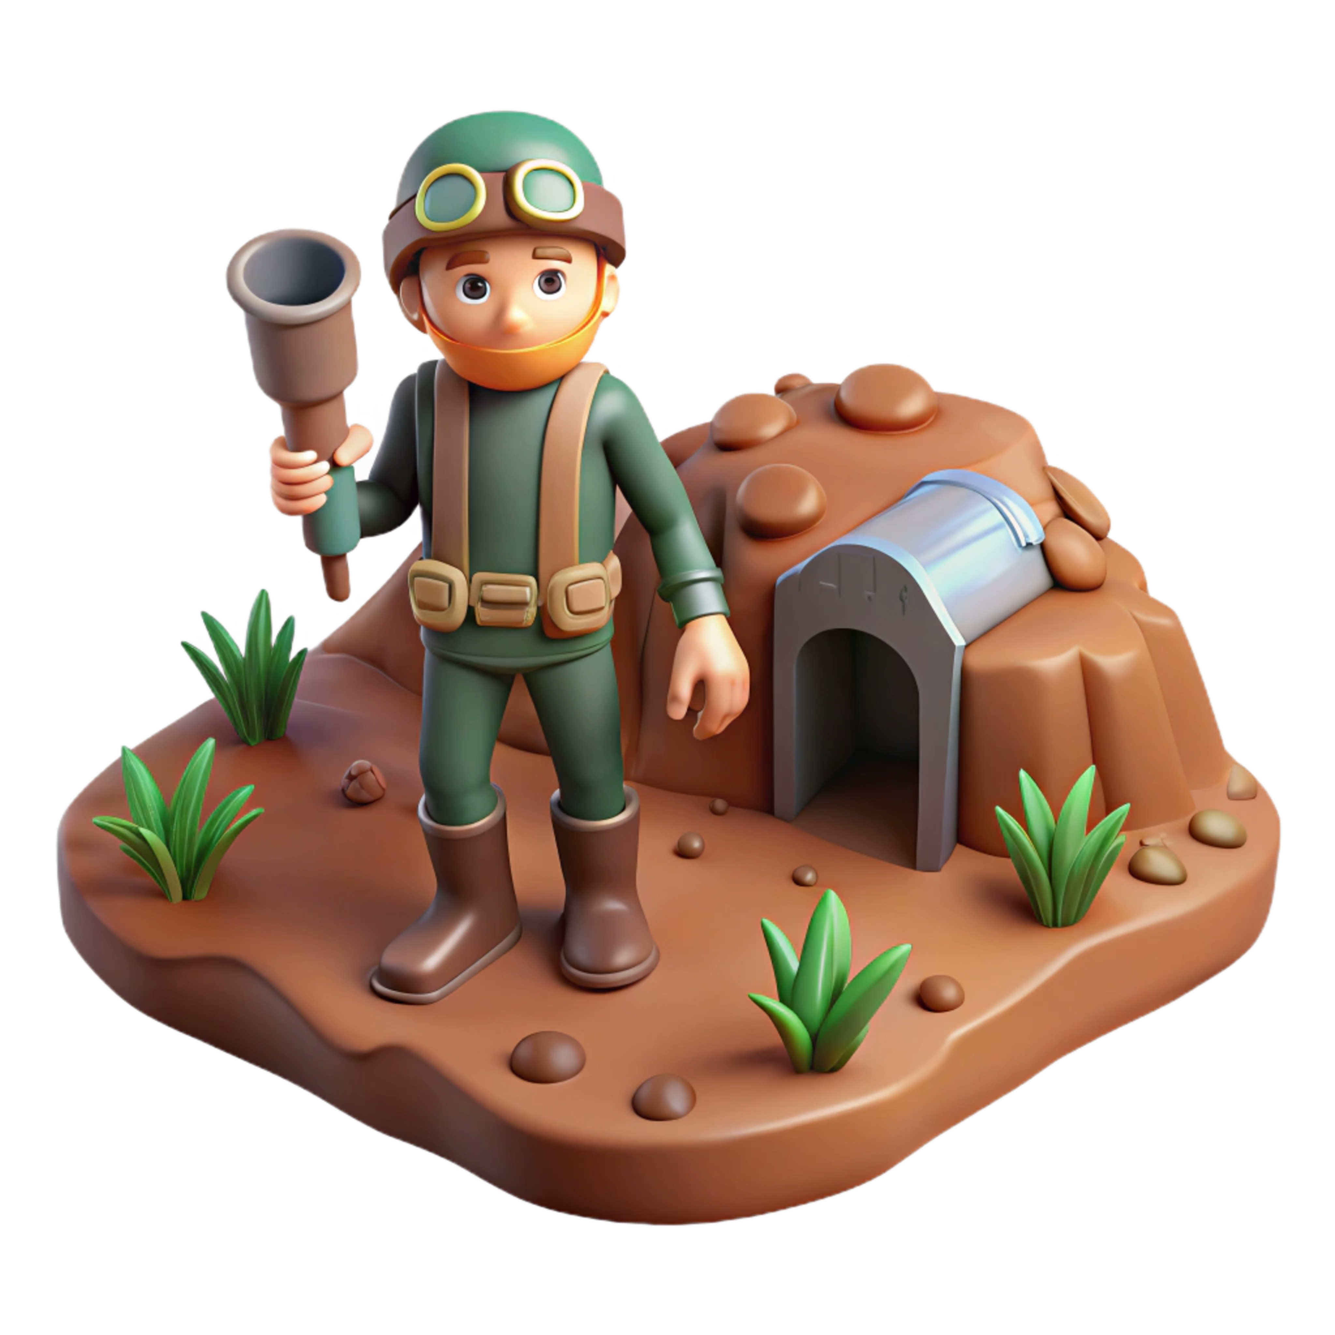
Underground Hero Navigation System
Player Login
Player Login
Play
Player
Registration
About the Game
Last
requirement
Game
Summary
Game starts
Fill 6 Boxes
Menu
Player Achievements
Player
History
Theme Picker
Level
Counter clock
Player Profile
Hero Leader board

